Slide 1
Tools and Visualizations for Exploring
Classification Landscapes
William Powers
Queens College, CUNY
New York, NY USA
wpqc21@gmail.com
Lin Shi
Queens College, CUNY
New York, NY USA
smilelinnn@gmail.com
Larry S. Liebovitch
Queens College, CUNY
Columbia University
New York, NY USA
LSL2140@columbia.edu
Abstract Neural networks and deep learning systems find the correct classification of input data by locating the corresponding local minima in the hyper-dimensional, classification landscape. An increasing number of adversarial examples have now shown that these networks sometimes find an unexpected and incorrect minimum and so make an incorrect classification. To understand those results requires a better understanding of the nature of these classification landscapes. Previous studies have explored the properties of the landscape of back propagation in training these networks. In our studies here, we explore the classification landscape of already trained networks. We present some novel procedures and analytical tools to study the classification landscape and visualizations to meaningfully represent those results. We apply these methods to study the classification landscape in classic examples, including image classification in the MNIST data set and flower classification from numerical feature values in the Iris data set.

Slide 2
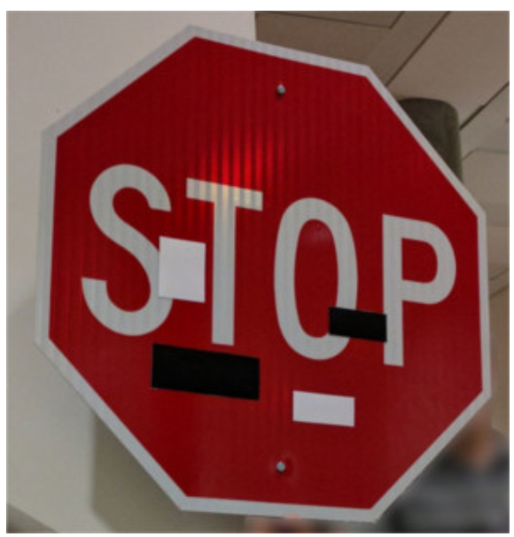
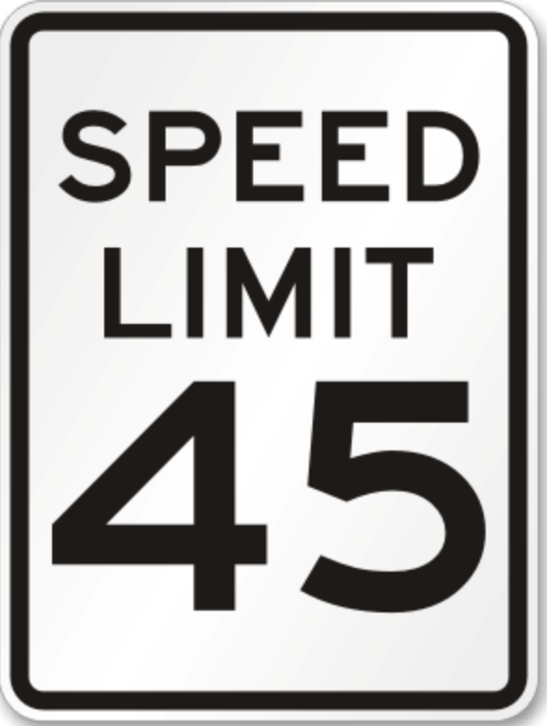
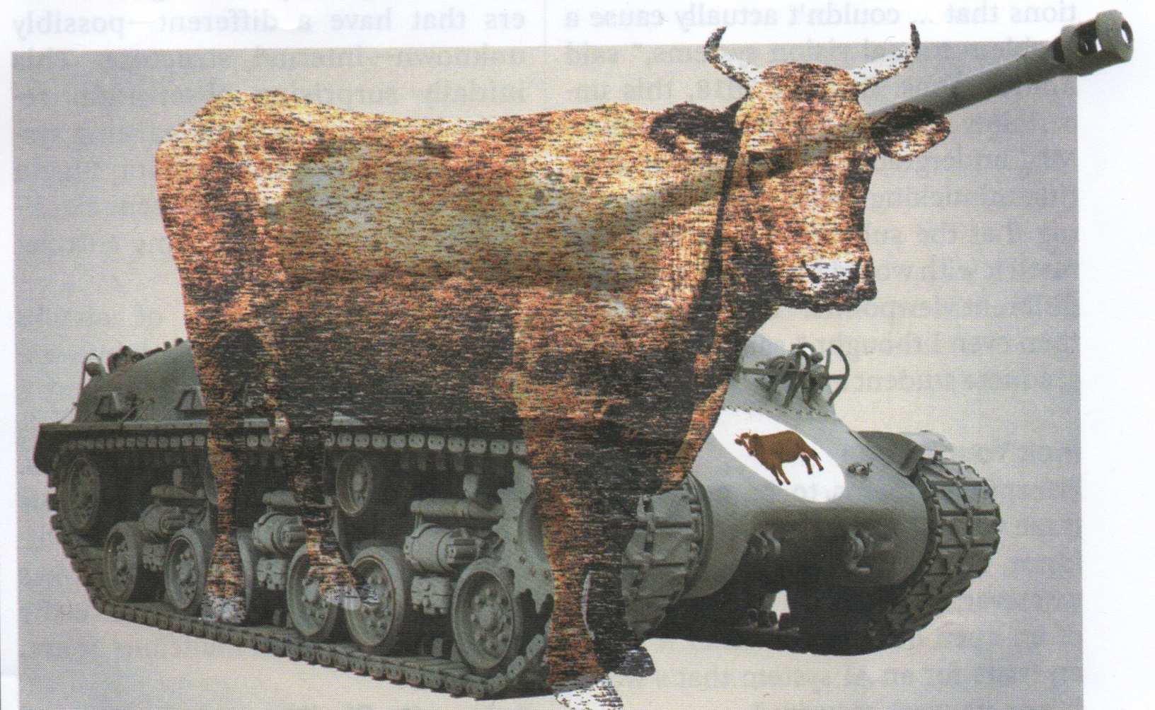
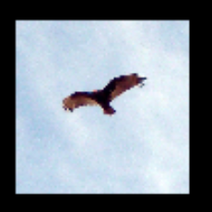
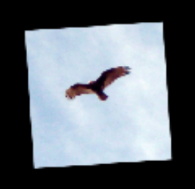
“Adversarial Examples”, “Hallucinations”
Small changes in input, BIG mistakes in ANN output.
input image
output classification
K. Eykholt et al. 2018. arXiv:1707.08945v5
cows in
a field
H. Siegel in D. Monroe 2021
Commun. ACM 64(No. 6)15-16
vulture
L. Engstrom et al. 2017. https://openreview.net/pdf?id=BJfvknCqFQ
orangutan

Slide 3
This talk
we suggest why this happens
tools we can use to understand it
visualizations to display those results

Slide 4
The Usual Picture
computation moves DOWNHIL
Force = D (potential energy) / D (distance)
slowly with lots of friction

Slide 5
What’s Wrong with this Picture?
These Classification Landscapes are
NOT 2-dimensional surfaces.
They have HUNDREDS or THOUSANDS of dimensions.
Our experiences/intuitions about 2-D landscapes are NOT TRUE for hyperdimensional landscapes.
For example:
Random Walks in 1-D and 2-D always get back to where you started (“recurrent”).
Random Walks in 3-D or higher NEVER get back to where you started.
Doyle & Snell 1984 Random Walks
and Electric Networks MAA
https://waitbutwhy.com/2015/03/7-3-billion-people-one-building.html

Slide 6
So What Goes On in these HIGH-D spaces?
Last few years very good work on the properties of the space in TRAINING networks.
How do the connection weights w_{ij} change as back propagation proceeds.
"the landscape is packed with a combinatorially large number of saddle points where the gradient is zero, and the surface curves up in most dimensions and curves down in the remainder. The analysis seems to show that saddle points with only a few downward curving directions are present in very large numbers, but almost all of them have very similar values of the objective function."
Y. LeCun, Y. Bengio, G Hinton. 2015. Nature 421:436-444. Deep Learning.
J. Goodfellow, O. Vinyals, A. M. Saxe 2015
Qualitative Characterizing Neural Network Optimization Problems.
https://arxiv.org/abs/1412.6544
D. J. Im, M. Tao, K. Branson 2017
An empirical analysis of the optimization of deep network loss surfaces
https://arxiv.org/abs/1612.04010
H. Li et al. NeurIPS 2018
Visualizing the Loss Landscape of Neural Nets
https://arxiv.org/abs/1712.09913

Slide 7
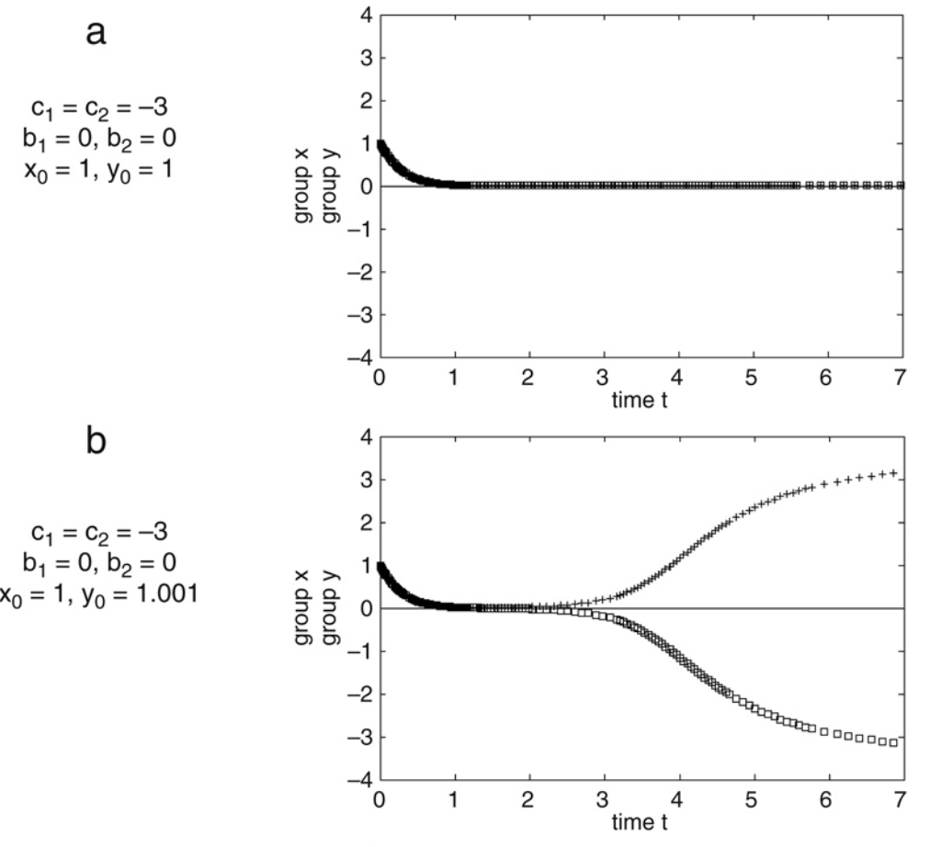
What is a saddle point?
attracting point
saddle point
saddle point
Liebovitch et al. 2008. Physica A 387 (2008) 6360–6378

Slide 8
Why are these hyperdimensional saddle
points important?
If we think of the classification landscape like this:
we make the WRONG intuitive guess that if we miss the correct minimum by a little bit, then we’ll land in a NEARBY local minimum with sort-of the same classification answer,
BUT if we understand that the classification space is really HIGH DIMESIONAL, we know that:
there’s a lot more “ROOM” up there
most of the critical points are SADDLES
this means we will BOUNCE around VERY FAR and wind up in a classification minimum VERY FAR away with a VERY DIFFERENT classification answer.

Slide 9
Strategy
STUDYING
CLASSIFICATION LANDSCAPE of a TRAINED NETWORK
NOT the ”LOSS” landscape during backpropagation training
NOT the “LOSS” landscape averaged over all the correct classifications
ASKING
Do SMALL continuous changes in the INPUTS lead to SMALL continuous changes in the OUTPUT classifications.
DO THIS BY
-constructing nearby inputs (by interpolation)
-SMOOTH or ABRUPT changes in the classification.
NOT able to directly observe the hyperdimensional structure
-small, local, neighborhood changes in 1-D and 2-D SLICES through the hyperdimensional structure
PRESENTING these results with some novel vizualisations

Slide 10
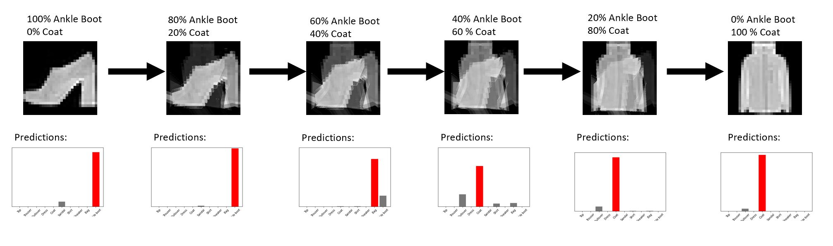
IMAGES Interpolated Small Changes
IMAGES
MNIST Fashion Data Set 70,000 28 x 28 pixel images of artilces of clothing
MORPHING
automorphing, Python-Image-Morpher
A. Jankovics 2020. https://github.com/jankovicsandras/autoimagemorph
D. Dowd 2021 https://github.com/ddowd97/Python-Image-Morpher
ankle boot
pullover, shirt, bag
coat
Result: UNEXPECTED mid-series changes in the classification.

Slide 11
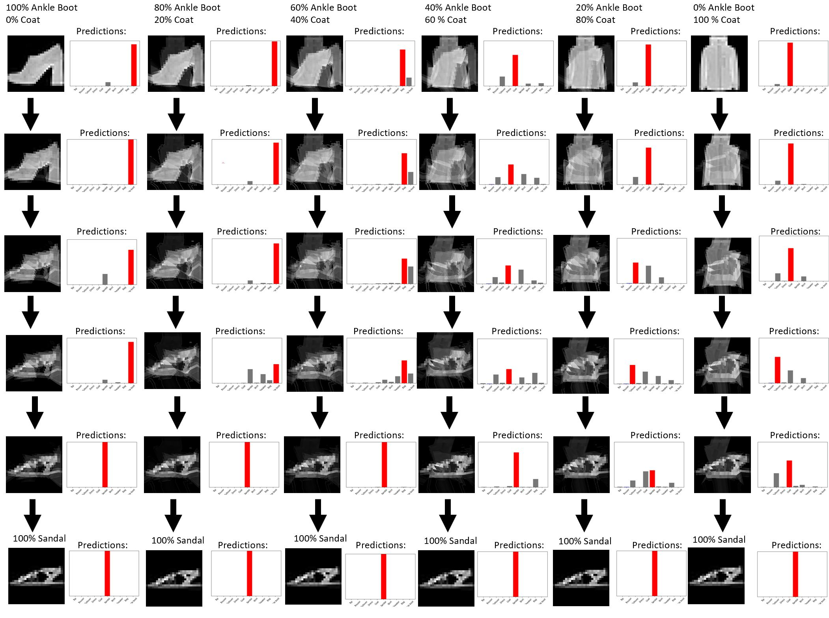
IMAGES Interpolated Small Changes
MORPHING 2-D slice

Slide 12
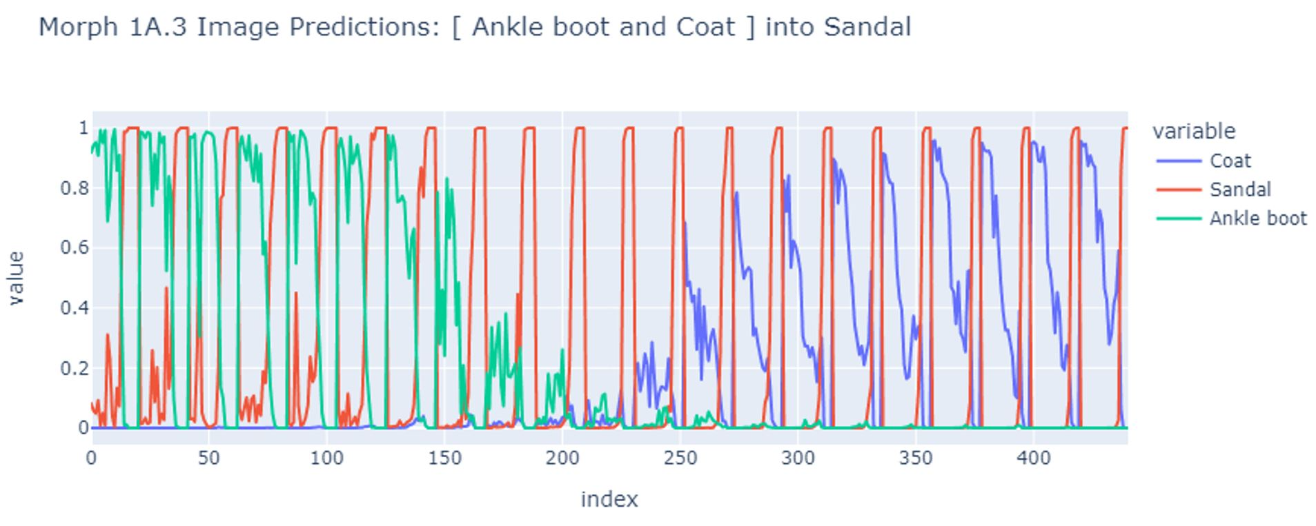
IMAGES Interpolated Small Changes
(ankle boot – coat) into sandal
Result: approximately smooth transition.

Slide 13
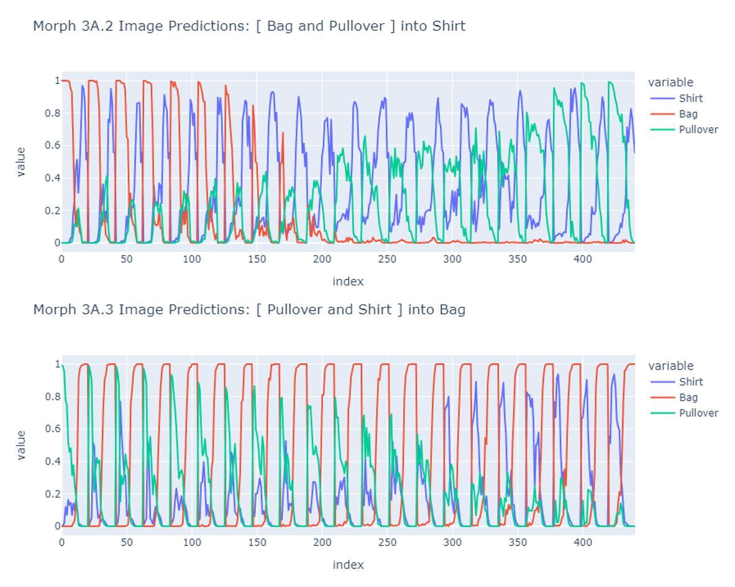
IMAGES Interpolated Small Changes
(bag – pullover) into shirt
(shirt– pullover) into bag
TOP: Sometime transitions not clearly defined.
BOTTOM: Sometime transitions well defined.

Slide 14
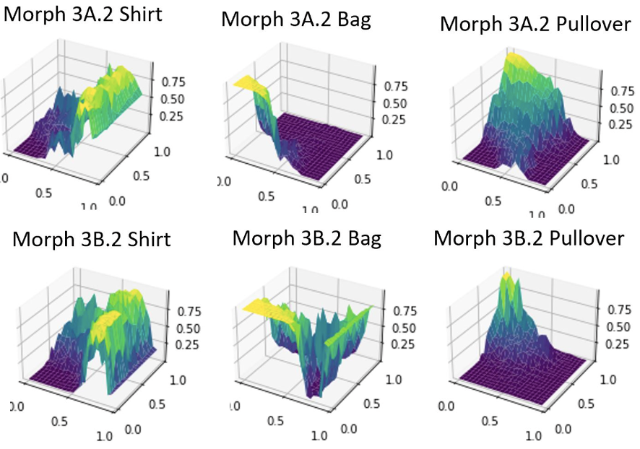
IMAGES Interpolated Small Changes

Slide 15
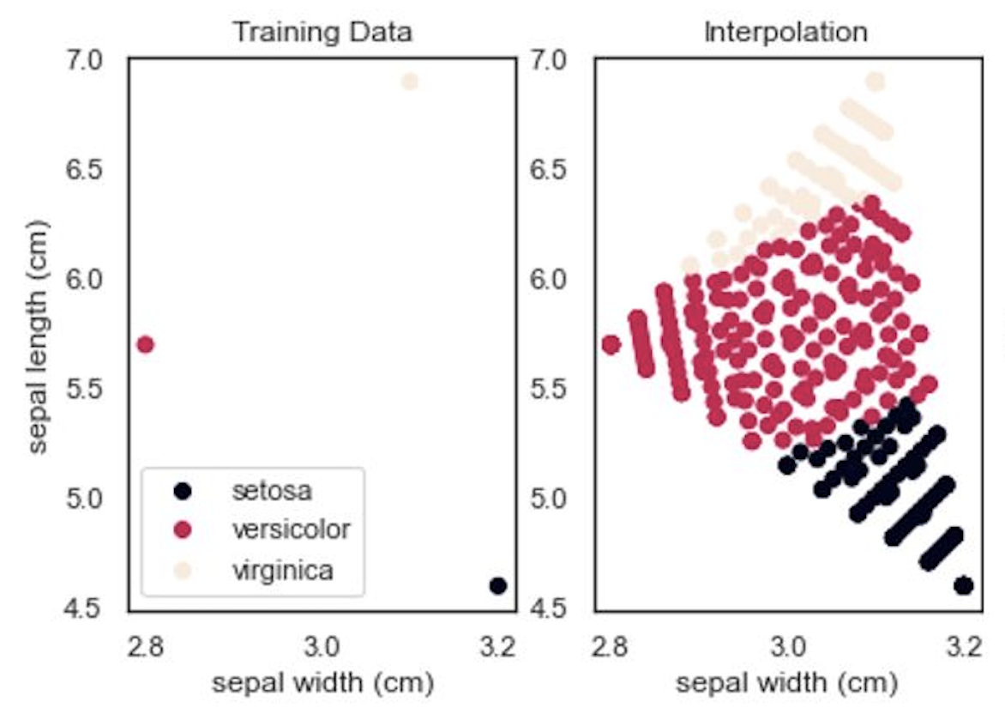
NUMBERS Interpolated Small Changes
IRIS 3 classes, 4 features
Iris: R.A. Fisher 1936.
linear 2-D interpolation
Result: NO ABRUPT or UNEXPECTED changes in the classification.

Slide 16
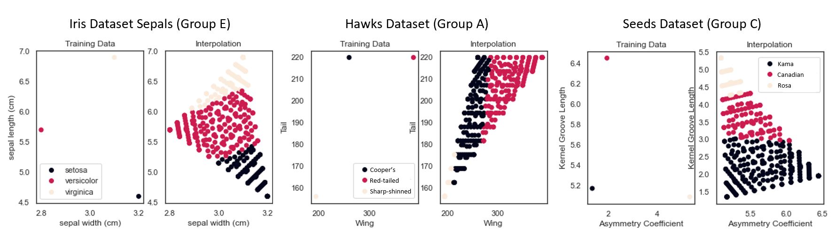
NUMBERS Interpolated Small Changes
IRIS, HAWKS, SEEDS 3 classes, 4 features
Iris: R.A. Fisher 1936.
Three Hawk Data Set A. Cannon et al. 2021 https://github.com/statmanrobin/Stat2Data
Wheat Seed Data Set M. Charytanowicz et al. 2010 in Pietka & Kawa Information Tech. in Biomedicine
Result: NO ABRUPT or UNEXPECTED changes in the classification.

Slide 17
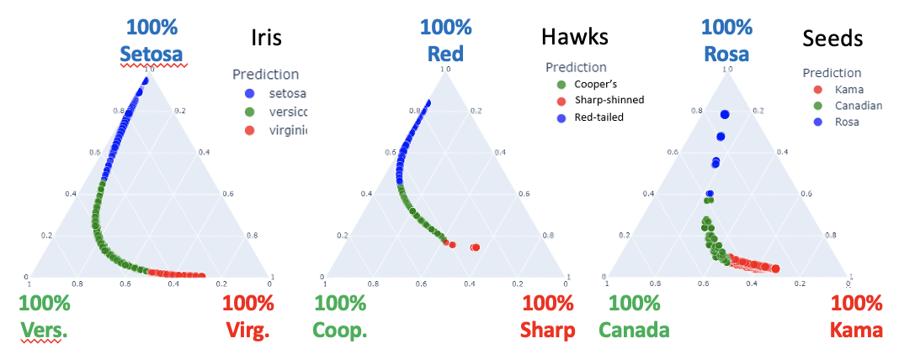
NUMBERS Interpolated Small Changes
IRIS, HAWKS, SEEDS 3 classes, 4 features\
”TERNARY PLOTS”
Alloys of 3 components: Pd-Ag-Cu
ADVANTAGE each point in 2-D is a unique combination of the 3 variables
DISADVANTED of the usual 3-D plot for 3 variables, is you see points falsley
shadowed onto the 2-D
Result: NO ABRUPT or UNEXPECTED changes in the classification.

Slide 18
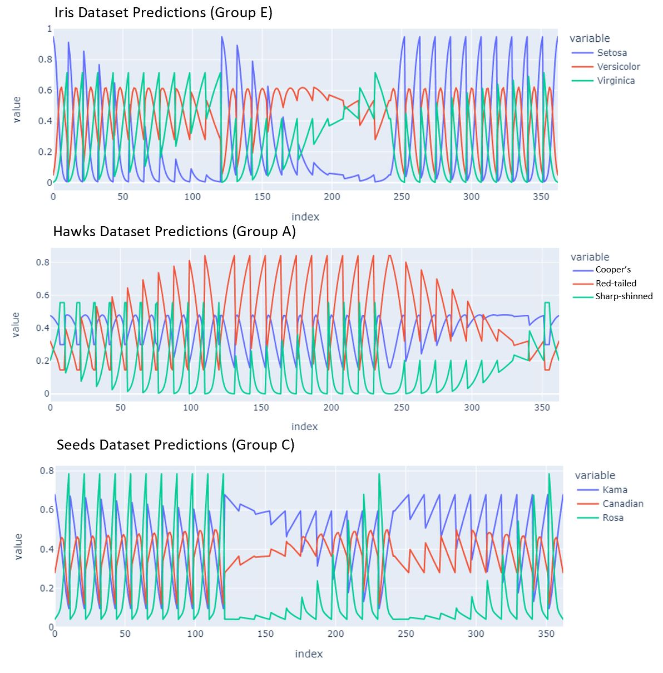
NUMBERS Interpolated Small Changes
IRIS, HAWKS, SEEDS
3 classes, 4 features
Result: Sometimes undecided between versicolor and virginica

Slide 19
RESULTS
ASKING
Do SMALL continuous changes in the INPUTS lead to SMALL continuous changes in the OUTPUT classifications.
ANSWER
Sometimes YES, sometimes NO.
IMPLICATIONS
This suggests that such UNEXPECTED results are an essential property of some Neural Networks.
We may need to explore other computational structures for AI to see if they are less likely to produce such (dangerously) wrong classifications.

Slide 20
Tools and Visualizations for Exploring
Classification Landscapes
William Powers
wpqc21@gmail.com
Lin Shi
smilelinnn@gmail.com
Larry S. Liebovitch
LSL2140@columbia.edu
https://sites.google.com/view/Larry-phd

